Slide 1
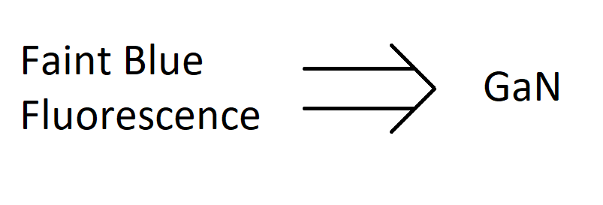
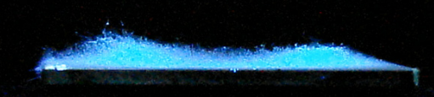
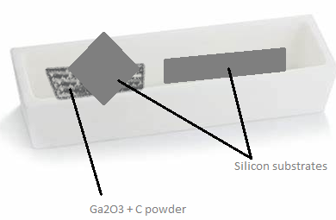
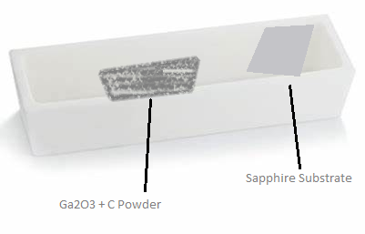
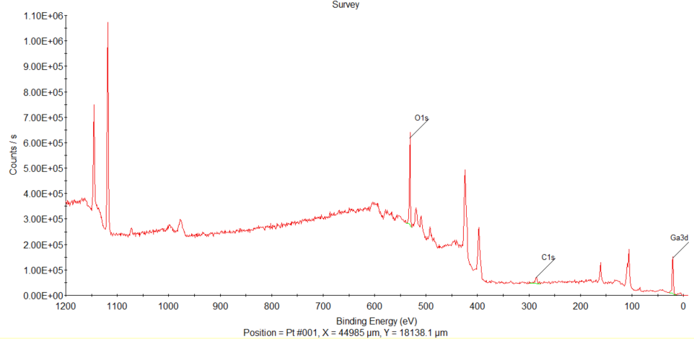
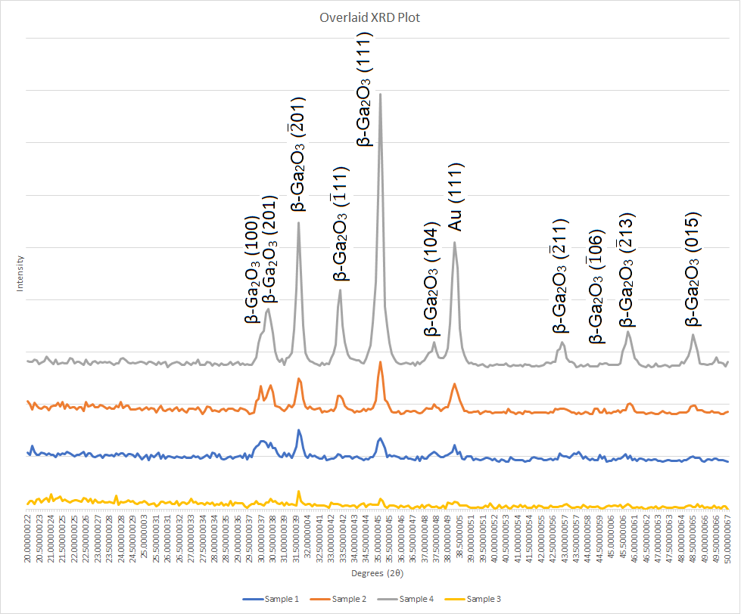
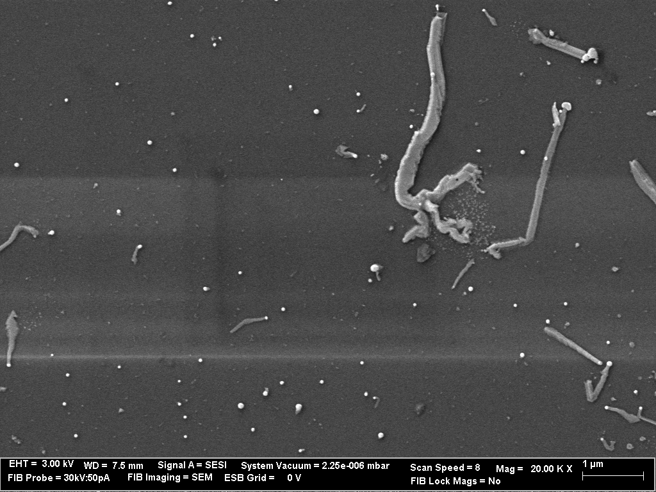
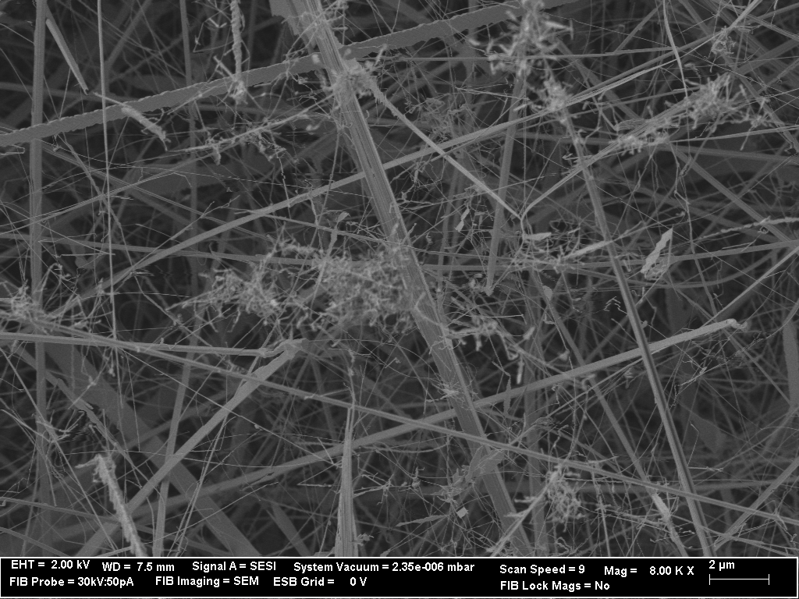
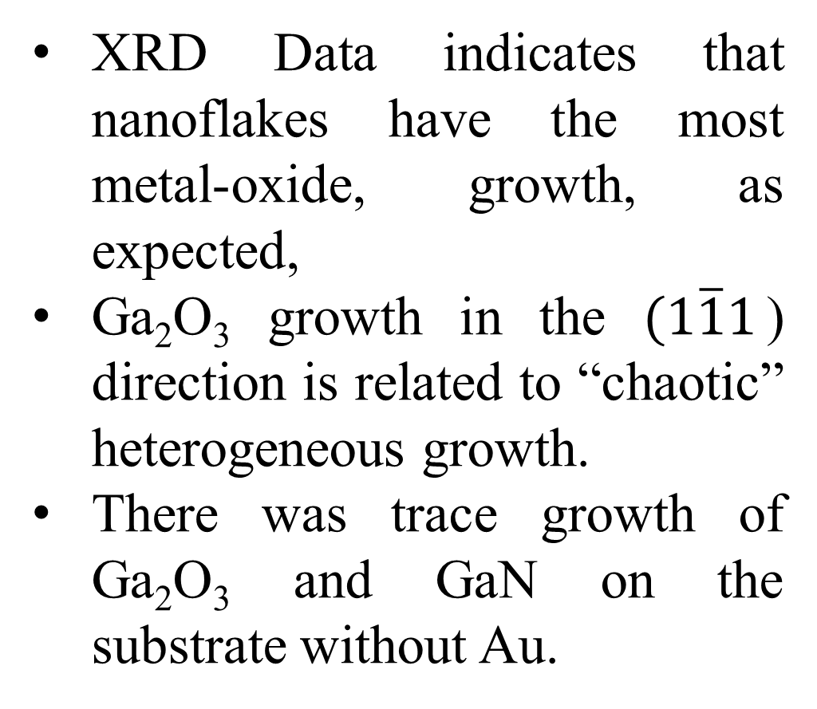
Synthesis and Characterization of Ga₂O₃ Nanowires and Nanoflakes
Pruthvi Banginwar^{a,b}, Meng Jiaª, Lars Gundlach^{a,b}
ªDepartment of Chemistry and Biochemistry, University of Delaware, Newark, Delaware, 19716, US
^{b}Department of Physics and Astronomy, University of Delaware, Newark, Delaware, 19716, US
Background
SEM Images
Transient Absorption
Fluorescence
Gallium Oxide is a wide band-gap (4.9 eV) semiconductor. Nanowires and other nanostructures of such materials are of particular interest due to potential semiconductor device applications.¹
Scanning Electron Microscopy (SEM) can help us understand the overall structure of the product.
Transient Absorption measurements use Ultrafast lasers to observe photochemical reactions within their ultrashort timescales.²
Taken with Auriga 60 Crossbeam FIB/FE-SEM
Nanowire width: ~200 nm on Silicon, ~80 nm on Sapphire
Nanowires have Au nanoparticles on tip or on root – indicating Au’s role as a catalyst
Seem to have no preferred orientation
Grow in “flakes,” “ribbons,” or “flags” if more precursor is used.
Ultrafast Transient Absorption measurements were complicated by multiple factors:
Photoexcitation wavelengths being too high for Ga₂O₃
Scattering of light due to randomly oriented nature of sample
GaN is a known blue-light emitter
Method
XPS
CVD methods used to grow nanowires on sapphire and silicon substrates using 50 nm Au nanoparticles as a catalyst.
Various parameters adjusted until desirable results were obtained.^{1,3,4,5}
a
c
d
a)
b)
Figure 5: XPS Data of nanowires grown on Si -- sample shown in Figure 3a. a) Ga^{2p}, b) O^{1s}, c) Au^{4f}, and d) full XPS Survey.
Ar flow
a)
b)
a)
Figure 1: Diagrams of arrangement of substrate and reactant in alumina boat for a) Nanowires on Si and b) Nanowires on Sapphire
Ar flow
d)
c)
b)
Parameter | Effect
Increase of Precursor | Denser & Thicker Nanowires
Increasing Ar Flow Rate | Thinner Nanowires
Increasing Substrate-Powder Separation | Sparse to None Growth (see Figure 2a)
Spin-Coating Au Nanoparticles | Insufficient Growth; Higher Concentration of Au Needed
Uniform Au Nanoparticle Coating | Uniform Area Growth of Nanowires
Placing Substrate Above Powder (Less powder, higher flow rate) | Less Homogeneous and “chaotic” nanowires (see Figure 2b)
Placing Substrate Above Powder (More powder, lower flow rate) | Nanoflake Growth (see Figure 1b)
Placing Substrate Besides Powder | More Homogeneous, “Clean” Nanowires
No Au Nanoparticles | No Growth (indicating Au’s role as a catalyst)
c)
d)
Figure 3: SEM images of a) nanowires grown on Si with gold nanoparticle catalysts visible at tip, b) nanoflakes grown on Si, c) nanowires grown on sapphire with gold spread onto substrate and d) nanowires grown on sapphire with gold drop-casted onto substrate
Au only observed when on surface (like Figure 3a, 3d)
Nitrogen present – likely GaN formed from N₂ presence in air
Exposure to air and oxygen allows the nanowires to grow longer and more intensely, which is something we wanted to avoid on the sapphire plates due to incompatibility with TA measurements.
Future Work
Even though 50 nm Au nanoparticles were used to form the nanowires, the tips of the nanowires appear to be closer to 200 nm in diameter. The reason for this is unknown. Proposed theories are that the gold liquefied and aggregated at 950 °C into larger nanoparticles, or that there is a layer of oxidized Gallium coating over the Au nanoparticles. Factors affecting this can be studied in the future to minimize overgrowth and have better control over nanowire size.
XRD Measurements
Figure 4: XRD plots of 1) Nanowires on sapphire without Au on the tip, 2) Nanowires on Si with Au at the tip, 3) Ga₂O₃ on Si without Au present, 4) Nanoflakes on Si with Au
XRD Data indicates that nanoflakes have the most metal-oxide, growth, as expected,
Ga₂O₃ growth in the $(1\overline{1}1$) direction is related to “chaotic” heterogeneous growth.
There was trace growth of Ga₂O₃ and GaN on the substrate without Au.
Acknowledgements
Funding: Unidel Foundation
Acknowledgements: University of Delaware Graduate College, Unidel Foundation, Gundlach Research Group, W. M. Keck Advanced Microscopy Facility
a)
b)
Figure 2: SEM images of a) sparse nanowire growth and b) chaotic and dirty nanowires

